Slide 1
Earthquake Readiness
The Importance of Being
Connected
CAPT Skip Lightner, PE
US HHS /ASPR / Regional Emergency Coordinator

Slide 2
Earthquake Readiness
Before
During
After

Slide 3
First a word from our sponsor
HHS – US Health and Human Services
  Secretary of Health – Kathleen Sebelius
ASPR – Assistant Secretary for Preparedness and Response
  ASPR – RADM Nicole Lurie, MD
OPEO – Office of Preparedness and Emergency Operations
  Dr. Kevin Yeskey

Slide 4
ASPR leads the nation in preparing for public health and medical emergencies
Our Mission:
Lead the country in preparing for, responding to, and recovering from the adverse health effects of emergencies and disasters by supporting our communities’ ability to withstand adversity, strengthening our health and response systems, and enhancing national health security

Slide 5



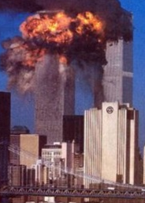
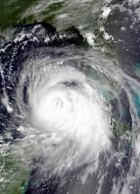

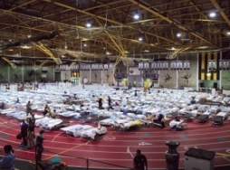
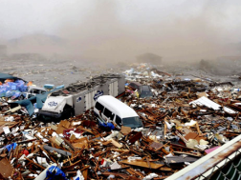
Protecting people’s health before,
during and after emergencies
MCM
Enterprise
Review
NHSS
Project BioShield
PAHPA
2001
2002
2003
2004
2005
2006
2007
2008
2009
2010
2011
H1N1
Pandemic
Deepwater Horizon
2011 Tornadoes
9/11 and
Anthrax
Katrina, Rita,
Wilma
Re-emerging H5N1
Ike, Gustav
Japan Earthquake
Nuclear Event
Haiti earthquake

Slide 6
ASPR works with partners from local
communities to global institutions
State, local,
tribal, &
territorial
governments
Emergency
management
community
Private
sector
Public health
Academia
&
research
institutes
ASPR
PARTNERS
&
STAKEHOLDERS
Healthcare
system
Non-
governmental,
faith-based, &
community
organizations
The public –
communities
& individuals
International
governments
& global
institutions
Federal
partners
Congress

Slide 7
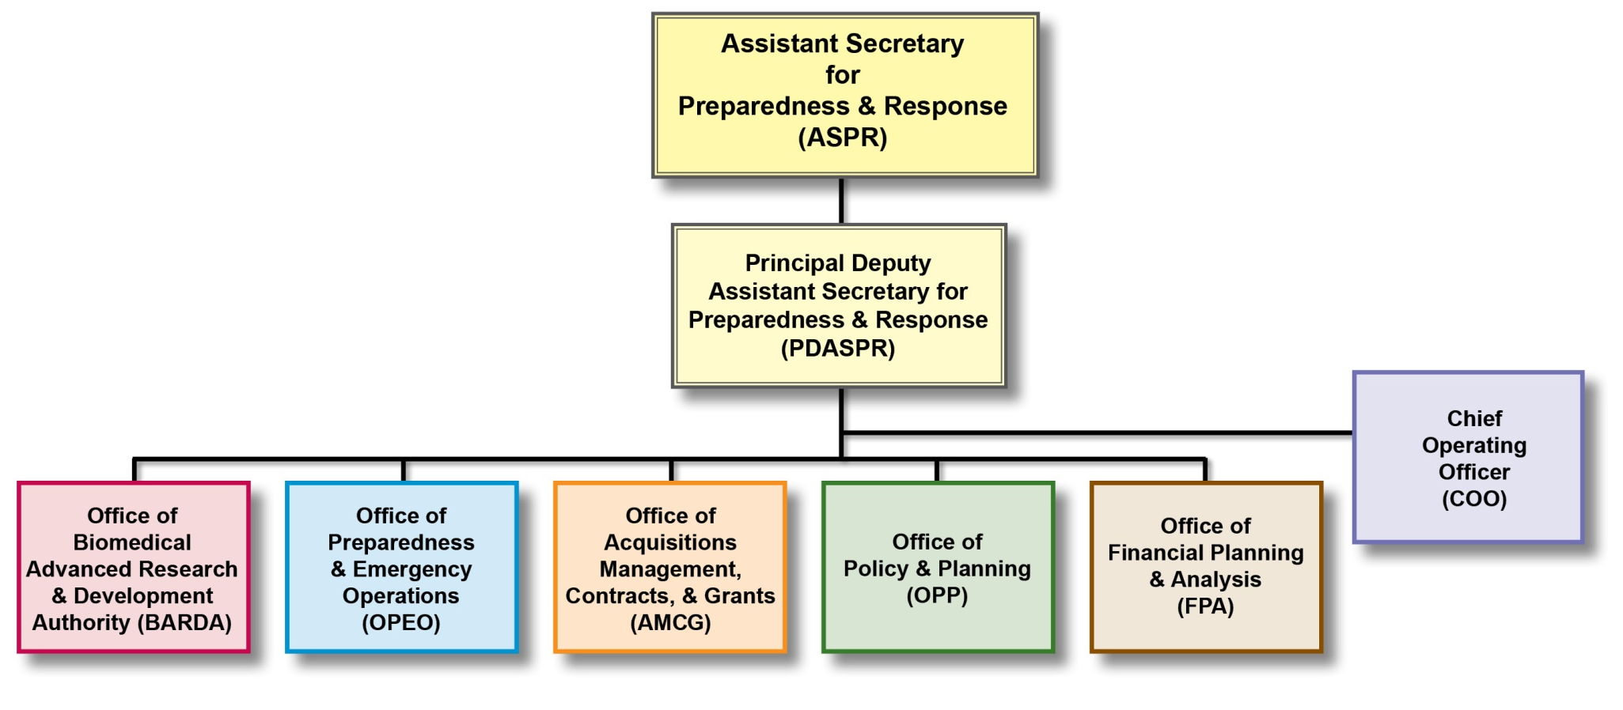
ASPR Organization
ASPR Organization

Slide 8
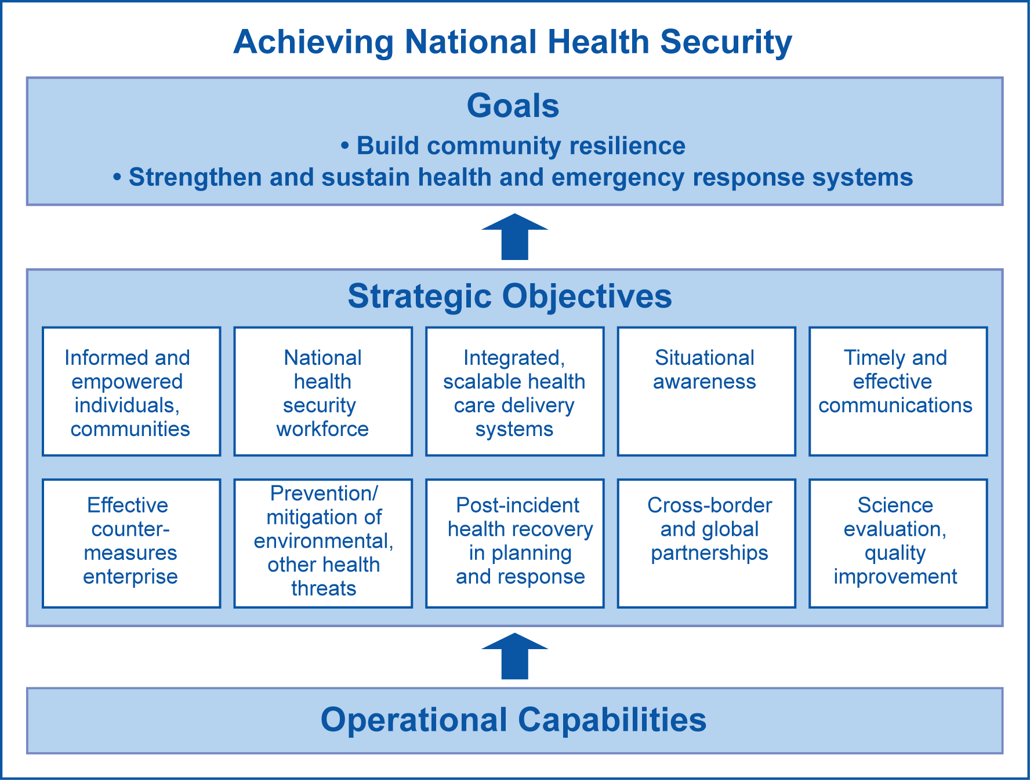
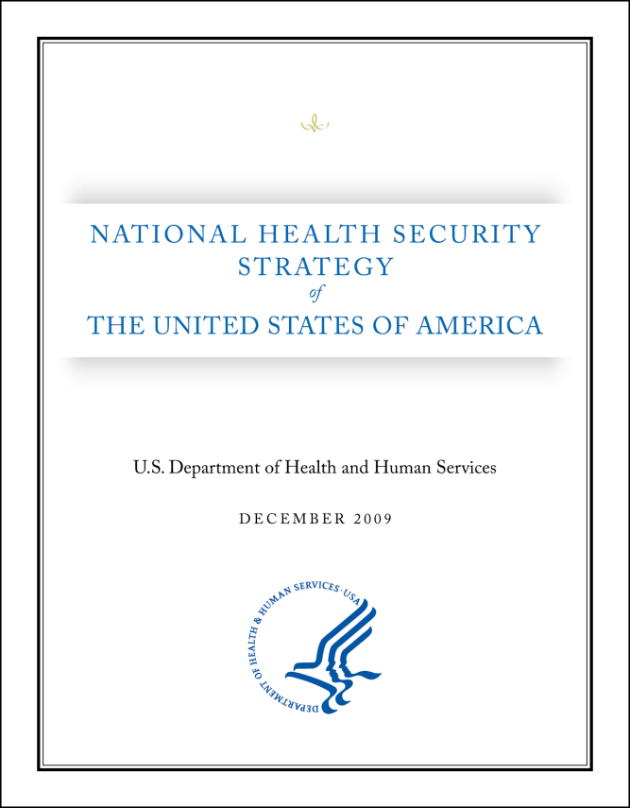
National Health Security Strategy

Slide 9
Career and Credentials
Education
  BS in Civil Engineering and MBA, from Tulane University, 1979 and 1985
Career as a Civil/Structural Engineer
  New Orleans: Carl E. Woodward (construction) and Linfield, Hunter (consulting)
  City of Grapevine, TX
  Federal Government: Indian Health Service and HRSA
Currently – ESF-8 lead and planning
  HHS Regional Emergency Coordinator , R6
  ESF-8 lead in disaster response / Public Health and Medical planning
  States of OK, AR, TX, LA, and NM
2009 Annenberg Senior Fellow – Best Practices in Government

Slide 10
Additionally
IHS Project sites - Claremore, Tahlequah, Pawnee, McAlister, Talihina, Stillwell, and Ada
HRSA - Moore, OK hospital for FHA loan program
Others:
  Numerous Navajo Nation projects
  Dental clinics throughout SW and Pierre, SD
  Underground storage tank removal

Slide 11
Structural Engineering Basics
Buildings –
  Provide living and work space
  Protect from elements
Therefore, buildings’ structures need to
  Withstand various forces / loads
    Wind, rain, snow in varying amounts
    How much? Location, history; forecasting / probability
    Static vs. Dynamic
Types of materials for structure
  Wood, concrete, steel, etc. All with differing strengths

Slide 12
Before: Many considerations
Frank discussion:
  How probable?
    A little or a lot?
The Big One
  The New Madrid Seismic Zone
  Small probabilities LARGE consequences?
How will OK be affected by the New Madrid?
  Depends on the intensity, the geology and other things I can’t even think of…

Slide 13
New Madrid Seismic
New Madrid Seismic Activity
Various Theories on its status
  Shutting down
  Random predictions
  Uncertainty over potential
Magnitude of disaster’s effect
  Memphis and St. Louis are major cities and hubs
    Damage to buildings, infrastructure, etc.
    Billions $$ and thousands of injured/deaths

Slide 14
Earthquake Histories
History of Oklahoma Earthquakes
  How many and at what magnitude?
    Since 1900, in OK:
    39 @ Magnitude 3.5 – 3.9
    9 @ Magnitude 4 – 4.9
    4 @ Magnitude 5+
History of Arkansas Earthquakes
  How many and at what magnitude?
    Since 1900, in AR:
    44 @ Magnitude 3.5 – 3.9
    17 @ Magnitude 4 – 4.9
    2 @ Magnitude 5+

Slide 15
Google Earth map of earthquakes in AR and OK
Google Earth Map

Slide 16
Notes:
To show 5.5 and higher

Slide 17
What to look for
Foundations and connections
  Not just the building itself
    Current building codes
Understanding: Probability and ground acceleration
  EQ force = some % of gravity
  http://earthquake.usgs.gov/hazards/about/basics.php
  How likely in a 50 year period would this happen?
What’s in your building that can topple?
    Bookshelves
    Light fixtures
    Anything overhead or heavy
    Facades

Slide 18
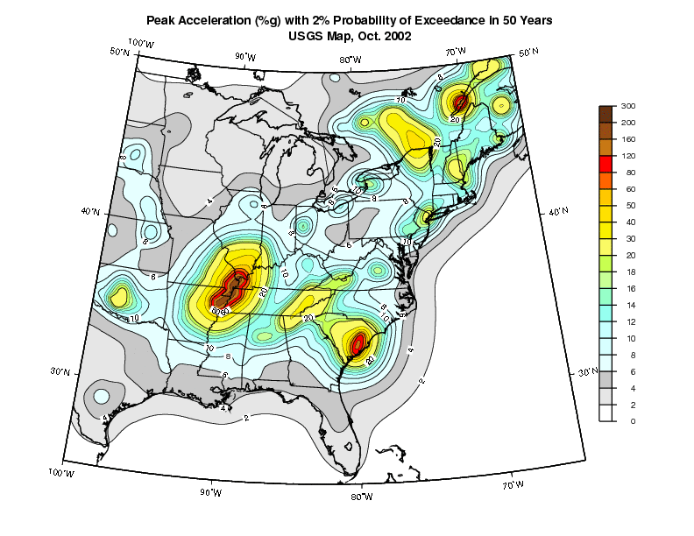

Slide 19
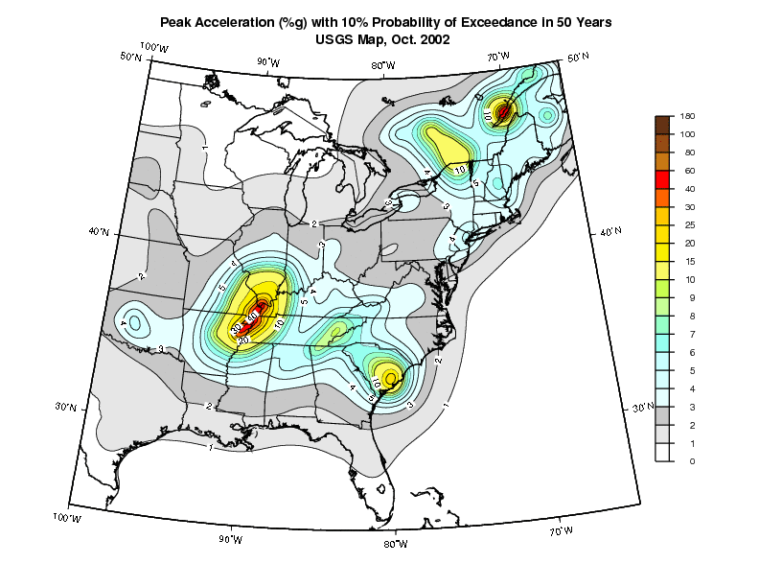

Slide 20
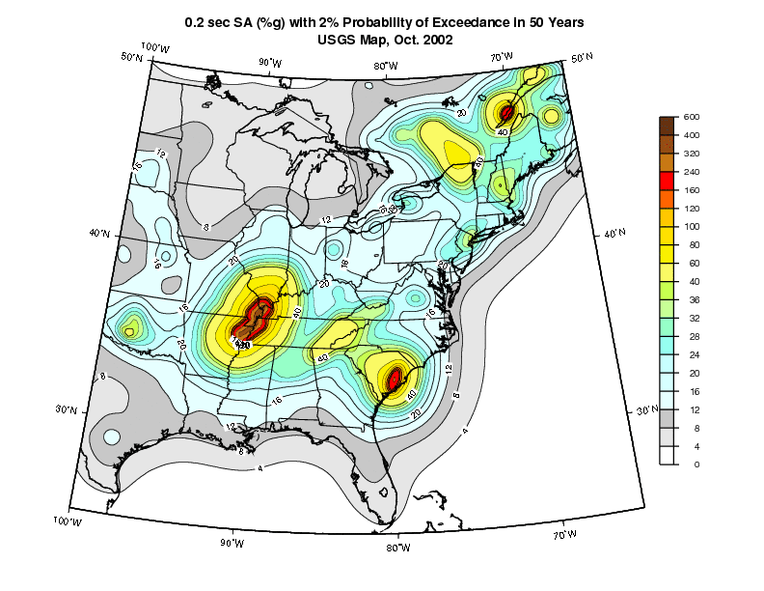

Slide 21
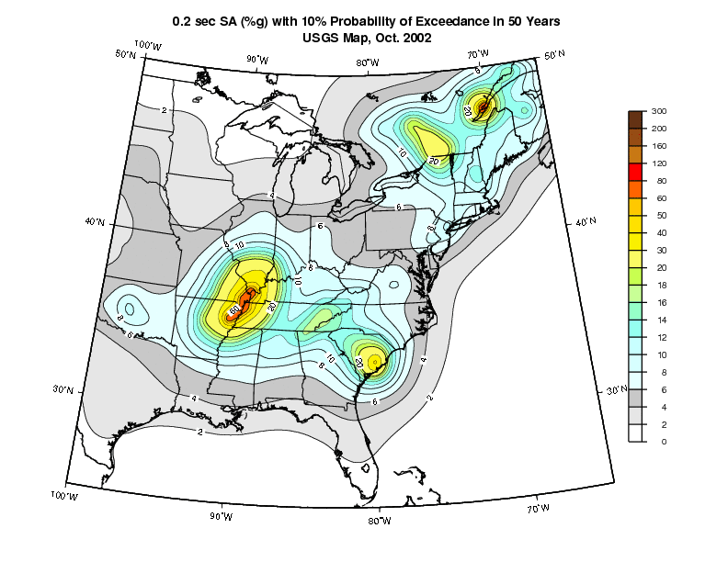

Slide 22
Notes:
1.3 g – this is what things may look at the center of an earthquake.

Slide 23
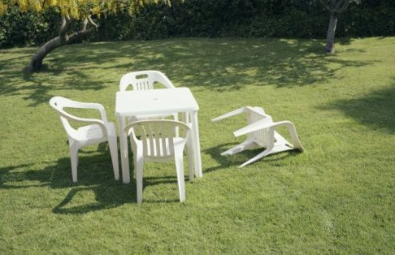
How bad will it be?
Notes:
So this is the big question.

Slide 24
Notes:
Everyday furniture becomes a danger.

Slide 25
Considerations
What’s already there?
  What can the building withstand already?
  Again building codes govern
    Soils and type of structure
    Existing and new
When should I worry?
  How strong an earthquake should I be concerned about?
  4.0? 5.0? 6.0?

Slide 26
During: Shake and Rattle
How long and how strong
Under a sturdy desk, chair, or table if necessary
Outside? Move away from buildings
  Facades and other exterior elements can break loose

Slide 27
After: The Survey
Around you
  If the buildin’ rockin’ don’t go a’knockin’
Be careful of all buildings and all facades.
In increasing concentric circles
  Immediate area
  Building
  Street and nearby infrastructure
Status of people
  Disoriented, injured, trapped?

Slide 28
Types of Failures
Soil and structural failure

Slide 29
Notes:
Liquidification

Slide 30
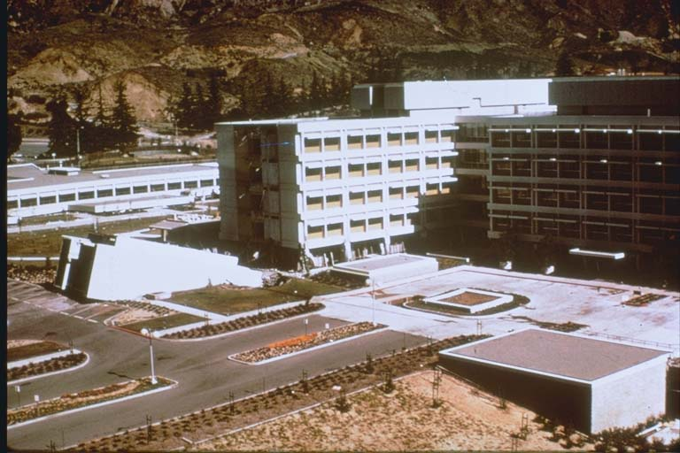
Fallen Structure

Slide 31
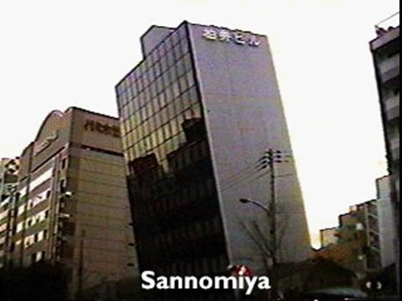
Tilted Building

Slide 32
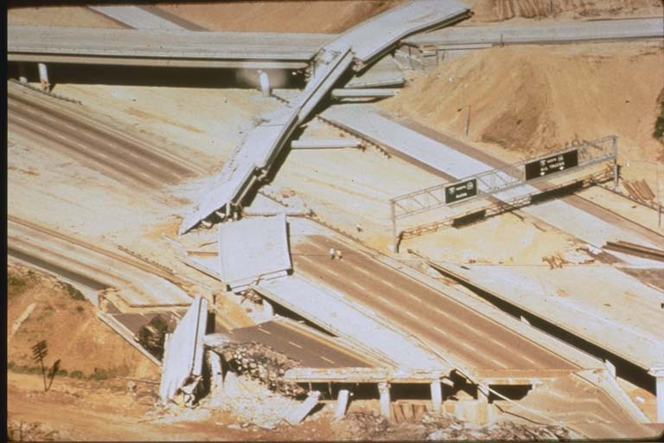
Highway bridge collapse

Slide 33
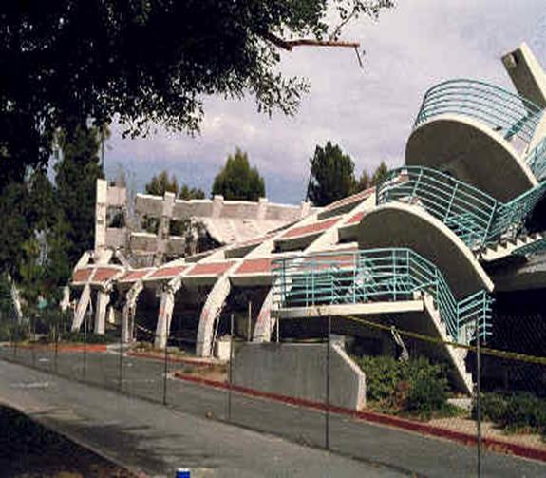
Bent parking structure

Slide 34
Recommendations
Any furniture or equipment – Straps and secure
  Tall and thin or narrow?
  Tall and long?
  Slightly unstable or on wheels?
Realize your true dangers – falling items from above, non-secured bookcases and tall equipment
Retrofit?

Slide 35
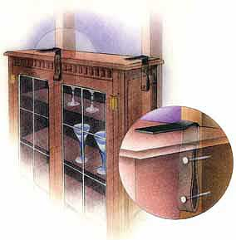

Slide 36
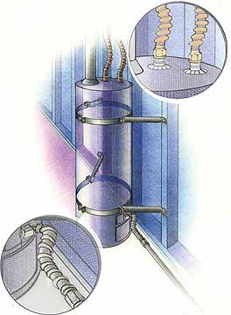

Slide 37
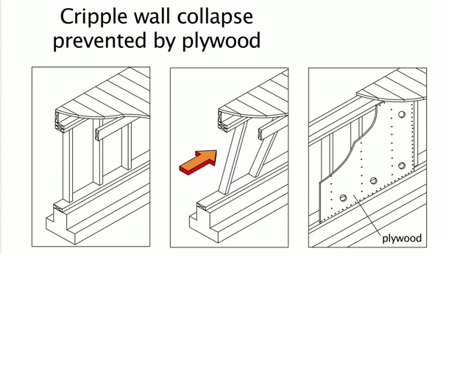
Bracing stud wall with plywood

Slide 38
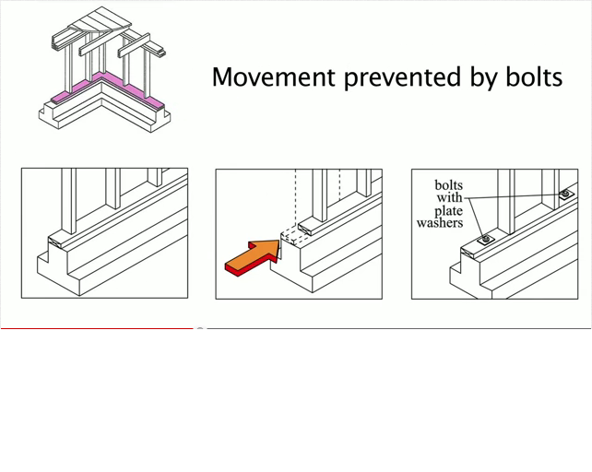
Connecting wall to foundation

Slide 39
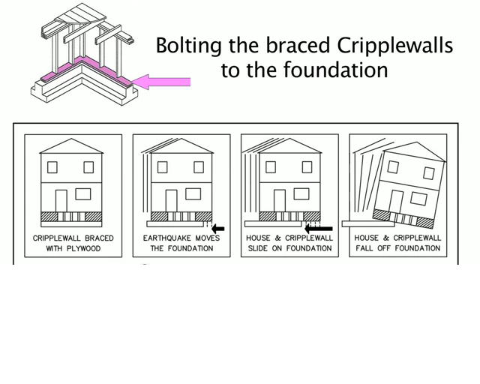
House sifting on foundation

Slide 40
Web sources
http://www.friendlyplumber.com/plumbing101/sanfranciscoearthquake10.html
http://www.tornadohistoryproject.com/custom/1096292/map
http://earthquake.usgs.gov/monitoring/anss/
http://www.ncedc.org/anss/catalog-search.html
http://earthquake.usgs.gov/hazards/about/workshops/thailand/downloads/070118--Luco_on_Ground_Motions_for_Design(v8).pdf
http://www.youtube.com/playlist?list=PL0C5802141ACD3CD5
http://web.ics.purdue.edu/~braile/edumod/eqphotos/eqphotos2.htm

